Slide 1

Learning driver preferences
ORTEC Belgium
Tim
Hellemans

Slide 2
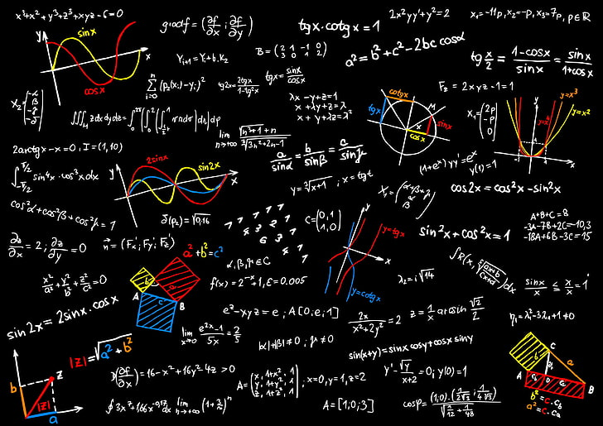
Outline
01
What is Consultancy?
02
Optimization engine
03
Learning preferences
04
Different roles in data

Slide 3

What is consultancy?

Slide 4
















Who am I professionaly?
Tim Hellemans
Master in (Fundamental) mathematics,
Phd Computer Science
Data science consultant @ Ortec Belgium & Data science teacher @ Syntra AB
For fun I like to:

Slide 5



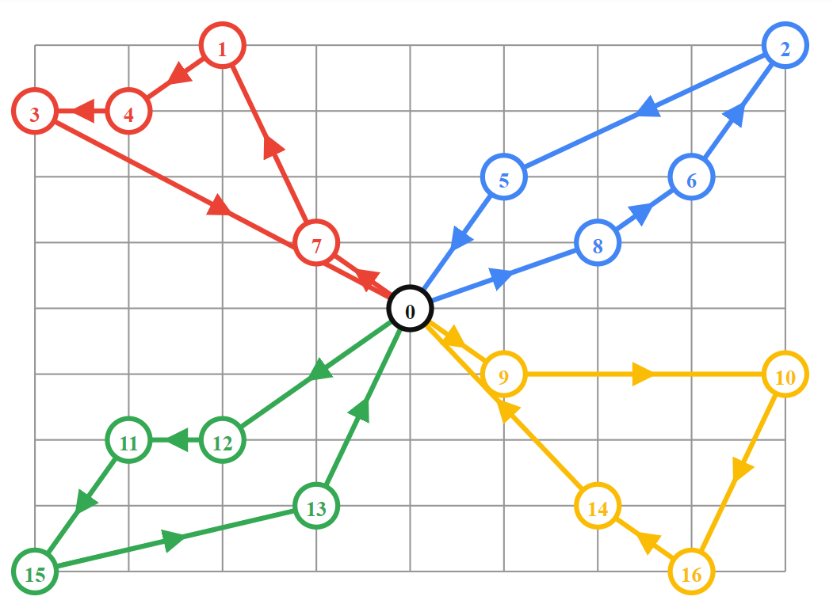
What is consultancy?

Slide 6
A day in the life

Slide 7
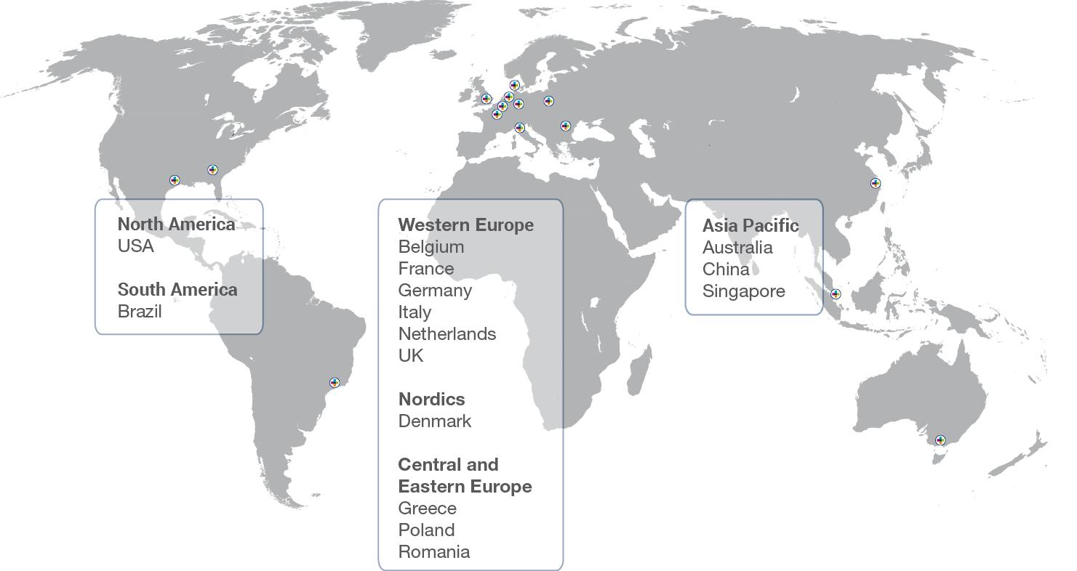

Slide 8
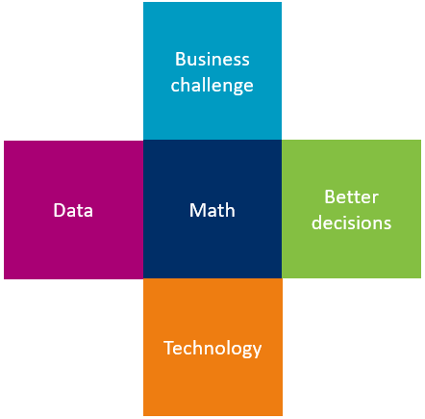
By leveraging data and mathematics, we enable better decision-making
Analyze your business challenge.
Collect relevant data.
Create a mathematical model. Solve it with mathematical techniques.
Use technology to enable it.
Leading to better decision-making.

Slide 9


Slide 10

Optimization engine

Slide 11
Optimization Complexity
Vehicles
Start Location
Visit Locations
A
B
C

Slide 12
Optimization Complexity
60 Solutions
2
3
1
1
3
2
2
3
1
1
3
2
1
3
1
2
2
3
3
2
2
1
3
1
1
3
1
2
2
3
3
2
2
1
3
1
2
3
1
1
3
2
2
2
1
1
1
3
1
2
2
3
3
2
2
1
3
1
1
1
1
2
1
2
2
2
1
1
2
2
2
2
1
1
2
2
2
1
2
1
1
1
1
1
1
2
1
2
2
2
1
1
2
2
2
2
1
1
2
2
2
1
2
1
1
1
1
1
1
2
1
2
2
2
1
1
2
2
2
2
2
1
2
1
1
1

Slide 13
Optimization Complexity
Vehicles | Locations | Formula | Solutions
3 | 3 | 3 x 4 x 5 | 60
3 | 6 | 3 x 4 x 5 x 6 x 7 x 8 | 20,160
3 | 9 | 3 x 4 x 5 x 6 x 7 x 8 x 9 x 10 x 11 | 19,958,400
5 | 25 | 5 x 6 x 7 x 8 x 9 x 10 x 11 x 12 x 13 x 14 x 15 x 16 x 17 x 18 x 19 x 20 x 21 x 22 x 23 x 24 x 25 x 26 x 27 x 28 x 29 | 368,406,749,739,154,000,000,000,000,000 = 368 x 10²⁷
m | n | m x (m + 1) x … x (m + n - 1)
For 5 vehicles and 25 locations → more than 10 trillion years calculation time

Slide 14
Optimization Complexity
Exact Methods
Small problem instances
Examine all solutions
Approximation Methods
Small to large problem instances
Optimization strategy modeled based on data, business rules, and objectives
Heuristics
Metaheuristics

Slide 15
Solution Approach
Construction
Strategy based on data, business rules, objectives, and planning processes
Local Search
Heuristics that locally search for improvements of the objectives: cost, distance, hours
Large Neighborhood Search
Metaheuristics that search on a local and global scale for improvements: Ruin and Recreate
Build Routes
Local Improvements
Global Improvements

Slide 16
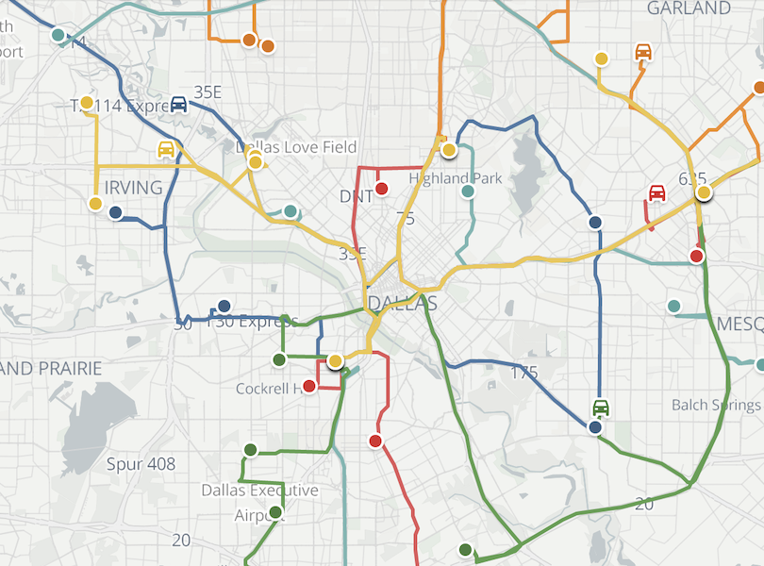
Brainstorm session
Brainstorm session Optimization methods

Slide 17
Phase 1 · Build Routes
Taking into account the business rules
Route #1
1
2
3
12
11
D
4
10
8
6
5
9
7
Route #3
Route #2
Unplanned Stops
Build Route #1
Build Route #2 and #3

Slide 18
Phase 2 · Local Improvements
Multiple improvements methods
Repeated multiple times
Within Routes
Between Routes

Slide 19
Phase 2 · Local Improvements
Move
Swap
Start Situation
Move Stop
Swap Stops

Slide 20
Phase 3 · Global Improvements
Optimize by making global changes
Cost
local minimum
local minimum
Solution Space

Slide 21
Phase 3 · Global Improvements
Ruin and Recreate
Solution
Choose whether to accept the new found solution
Choose a ruin method to remove a part of the solution
Acceptance
Ruin
Choose whether to try to improve the new found solution
Local Search
Recreate
Choose a recreate method to find a new solution

Slide 22
Phase 3 · Global Improvements
Ruin and Recreate
Random Select Stops
Start Situation
Remove Stops
Re-insert Stops

Slide 23
Adaptive Large Neighborhood Search
Filters out
‘bad methods’
Easy to
implement
Roulette Wheel
Adaptive
Diversification
Can handle
many
problems

Slide 24
Brainstorm session
Brainstorm session Implementation @ customer

Slide 25
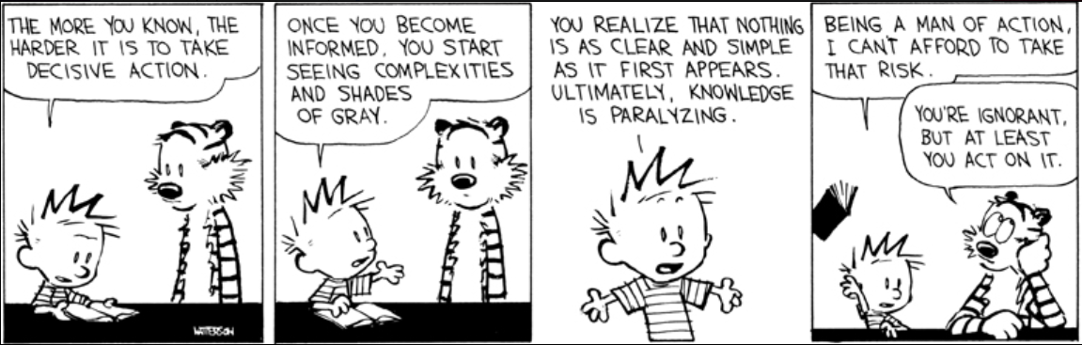
Learning preferences

Slide 26
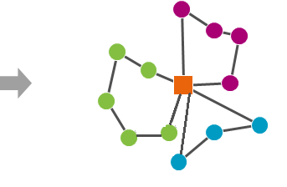
Problem setting
Move
Start Situation
Optimal solution
Used solution

Slide 27
Sub-problems
Removing locations
A driver decides to remove certain locations from his route
Adding locations
We need to add these locations to some other route
Reordering route
Use an alternative order of the locations on a route.
Can be seen as combination of adding & removing.

Slide 28
Do drivers actually find a better theoretical solution?
In general: no, not really..
Remark: Although the routes look worse on paper, there can still be a lot of value in the driver’s choices!
Cost optimized route | Cost driver | Difference
1065.615 | 1150.218 | 7.94%
634.564 | 652.097 | 2.76%
1015.78 | 1051.991 | 3.56%
1000.486 | 1021.003 | 2.05%
1007.807 | 1043.514 | 3.54%

Slide 29












Further than cost saving: the human factor
FACT
Drivers are a scarce and precious resource
Drivers have knowledge and experience that is difficult to capture in “mathematics”
Drivers are frustrated with plans that don’t “feel logical” to their way of working
Implicit feedback: log and monitor differences between planned vs actual (package swap)
Explicit feedback: give drivers the chance to rate stops and routes
Our current focus
capture driver’s knowledge, experience and preferences
FEEDBACK
Thinking in terms of sequential steps will not allow us to tap in the human factor
Thinking in of continuous improvement allows to directly feed the feedback into tactical and operational plans

Slide 30
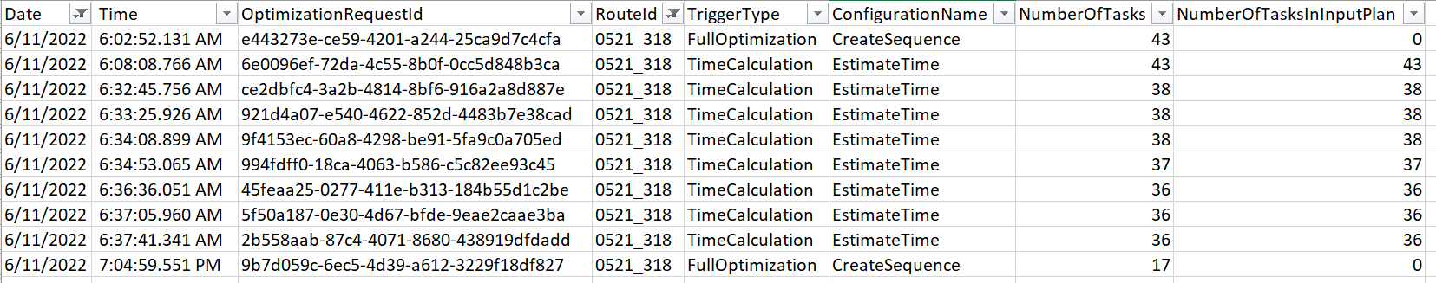
What does an optimization cycle look like?
Are requests only removed?
Single day, only morning, single route
Compare the request last request with the first response

Slide 31
Removing locations
Selected route
Probability of removing the location
Locations in route
Route ordered | Prob of removing
Location 1 | 10%
Location 2 | 30%
Location 3 | 4%
Location 4 | 90%
Location 5 | 30%
Location 6 | 20%
Location 7 | 80%
Suggest to driver that he might want to remove this location

Slide 32
Adding locations (that were removed)
Selected route
Probability of adding the location
Location that can be added
Locations that have been removed | Prob of adding
Location 4 | 5%
Location 7 | 90%
Suggest to driver that he might want to add this location

Slide 33


Slide 34
What features to use?
Location
Feature | Status
Is a hub? | To be investigated (computed or available?)
Package info | To be requested
Time of delivery | Computable
Relative time of delivery | Computable
Distance/time to neighbouring locations | Available
Multiple occurrence in route | Computable
Location Coordinates (grouped) ZIP code Street name … | Available though functioning API of maps team
Time windows | ?
Route
Feature | Status
Driver | To be requested
Package info | To be requested
Total route length (time) | Computable
Start time/end time | Available
Location of stops | Available
Earliest/latest times | ?
In real world: Start collecting features at the start of a project but make a PoC with subset of features

Slide 35

Predictability of removing nodes

Slide 36
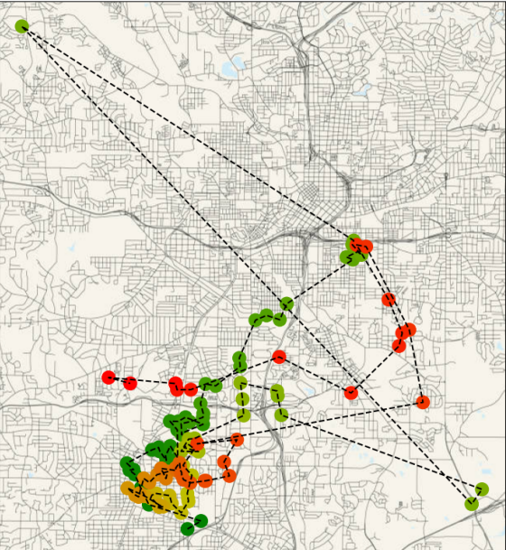
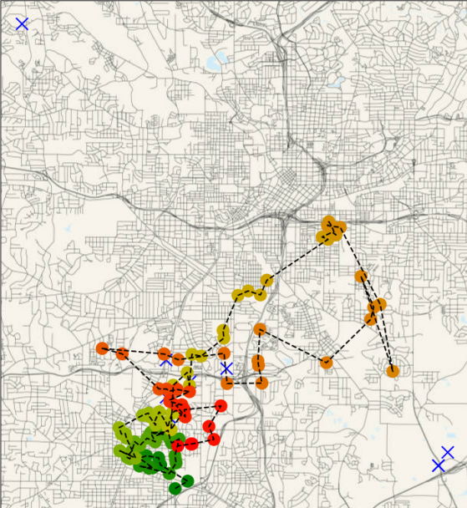
Problem setting

Slide 37
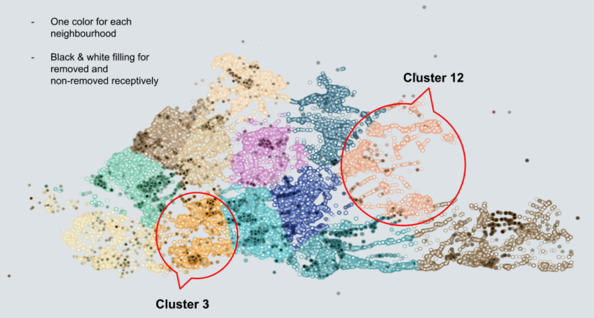
Visualizing removed nodes

Slide 38
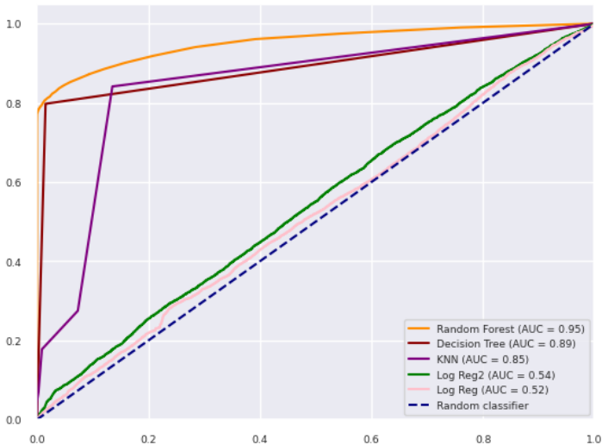
Measuring model performance
Predicted that a driver would remove a location & he actually removed it (True Positive)
Predicted that a driver would remove a location but he didn’t (False Positive)

Slide 39
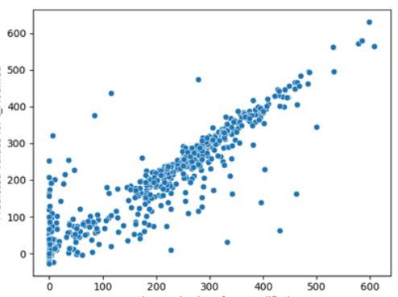
Predicting the total number of changes
Predicted number of changes
Actual number of changes

Slide 40
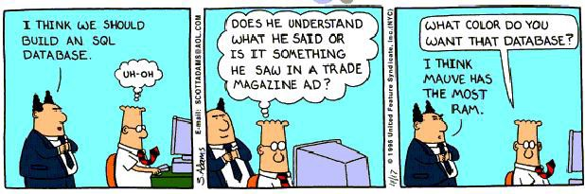
Different roles in data science

Slide 41


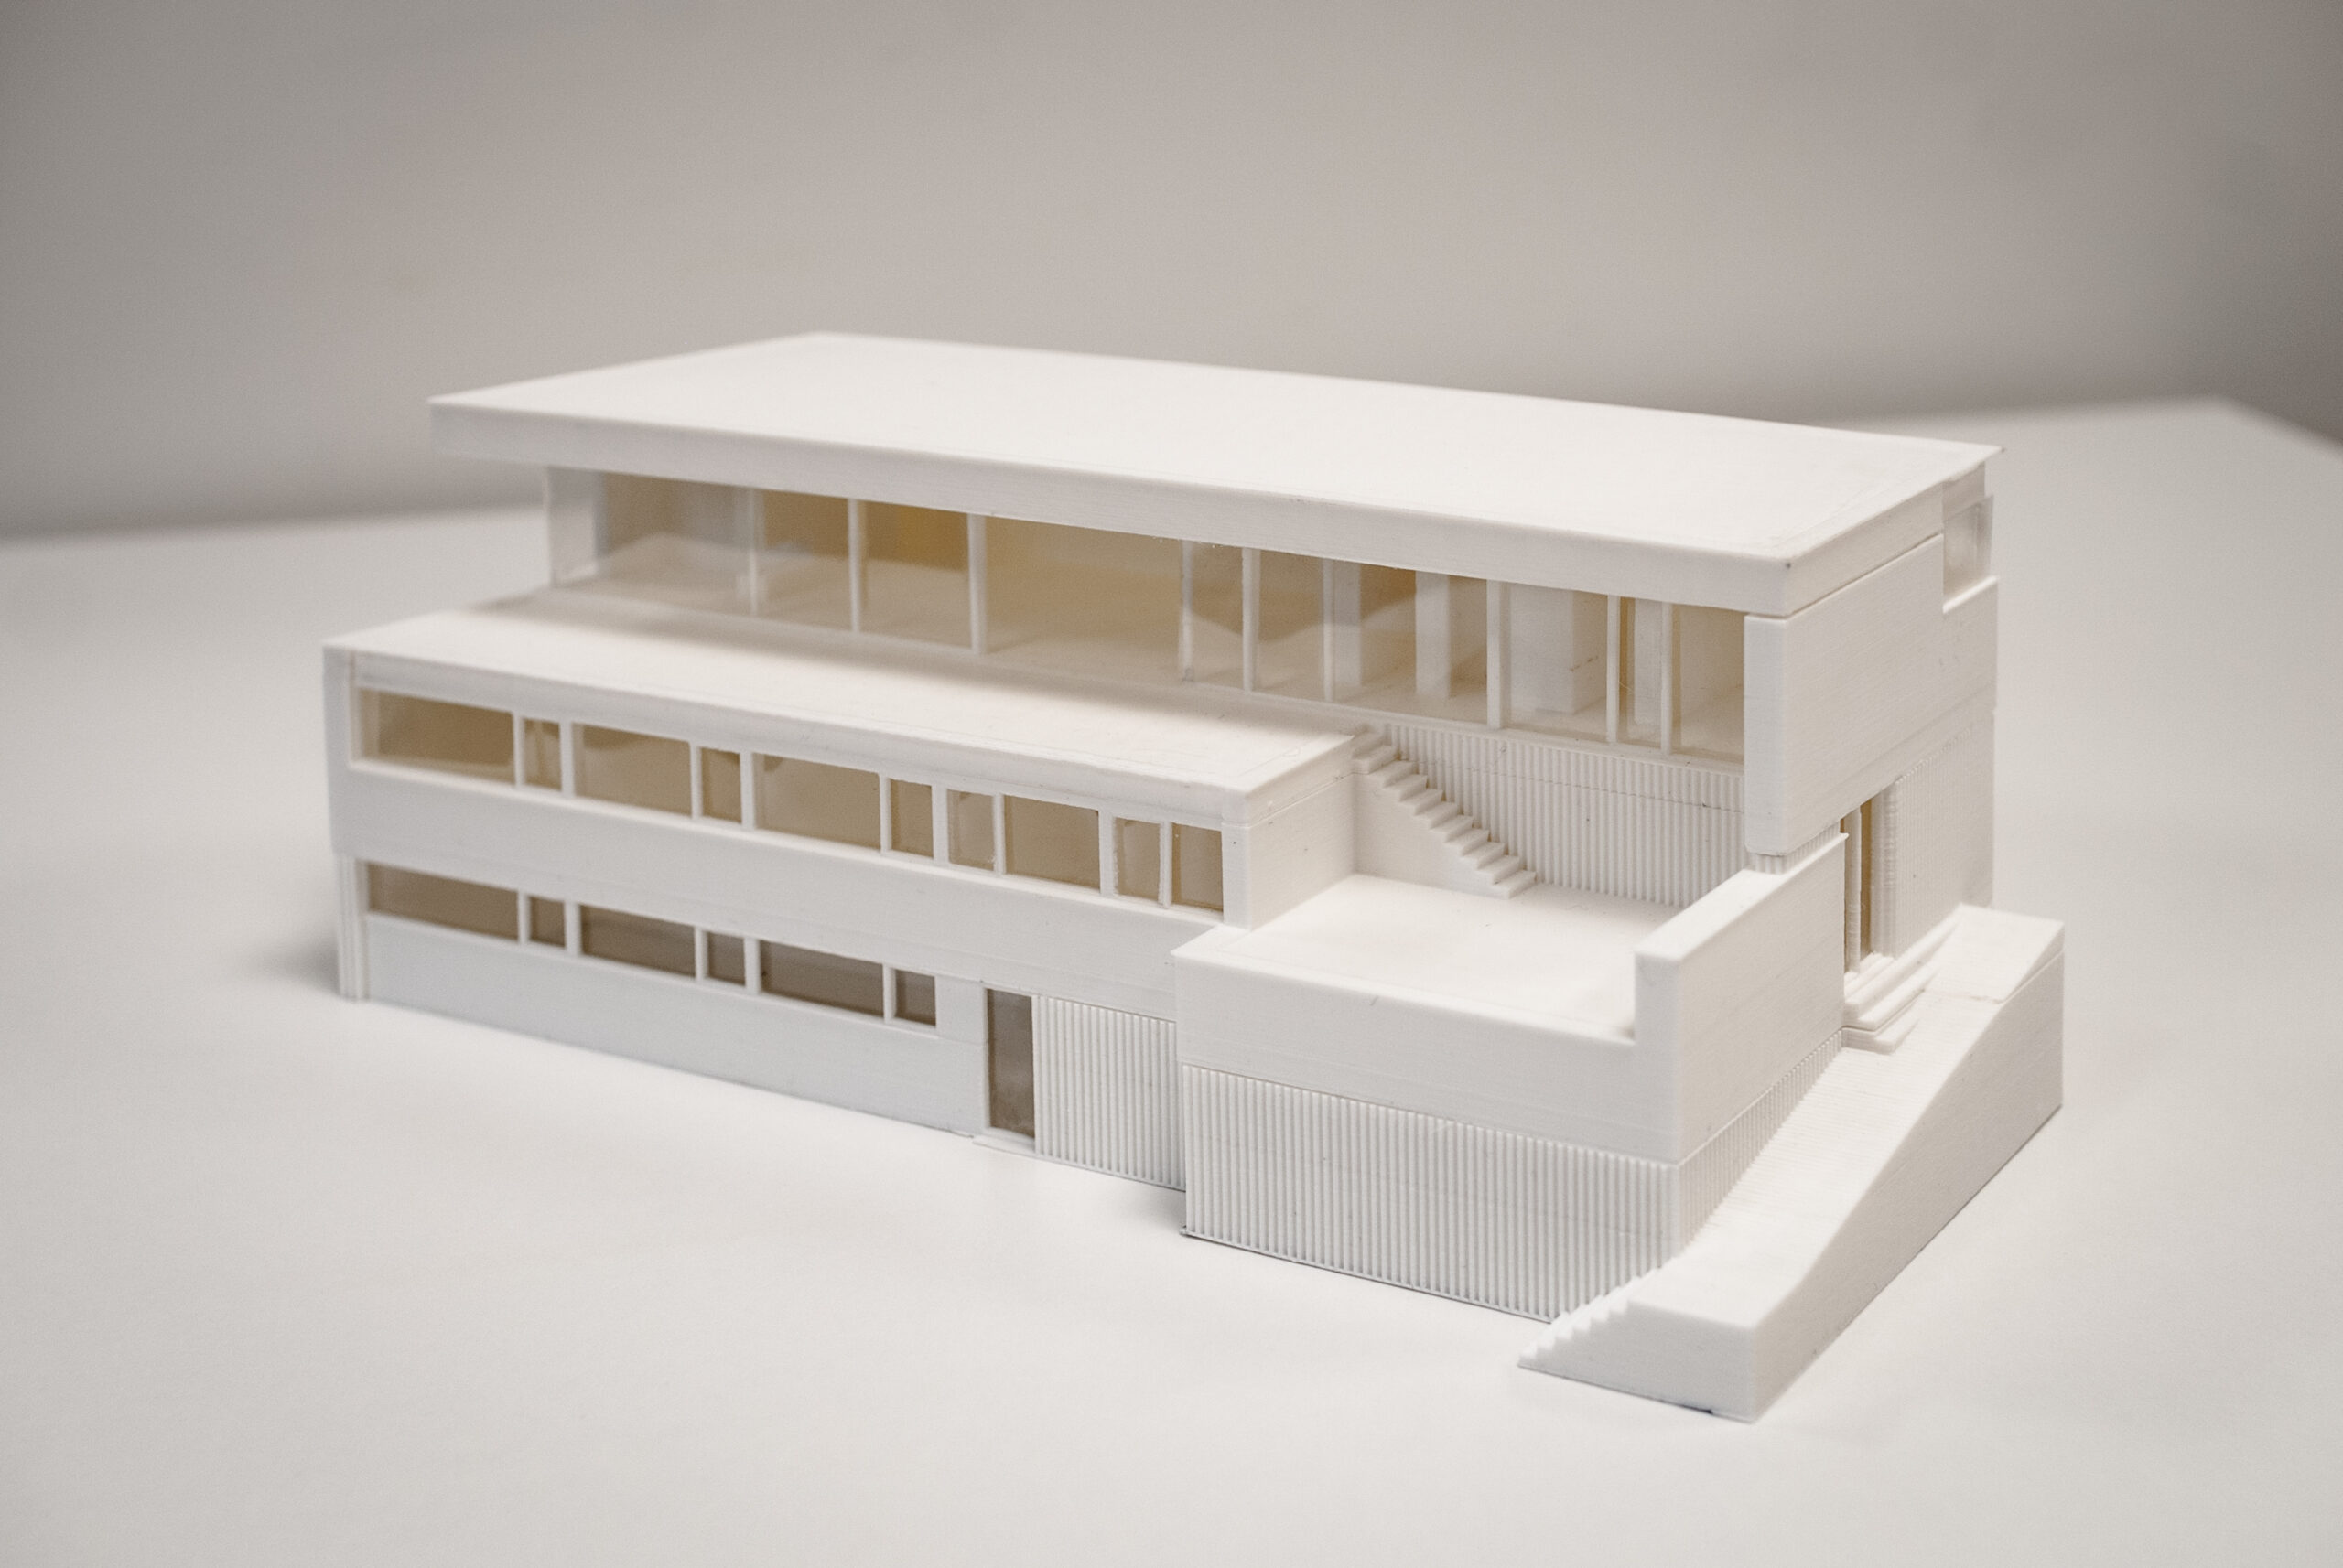
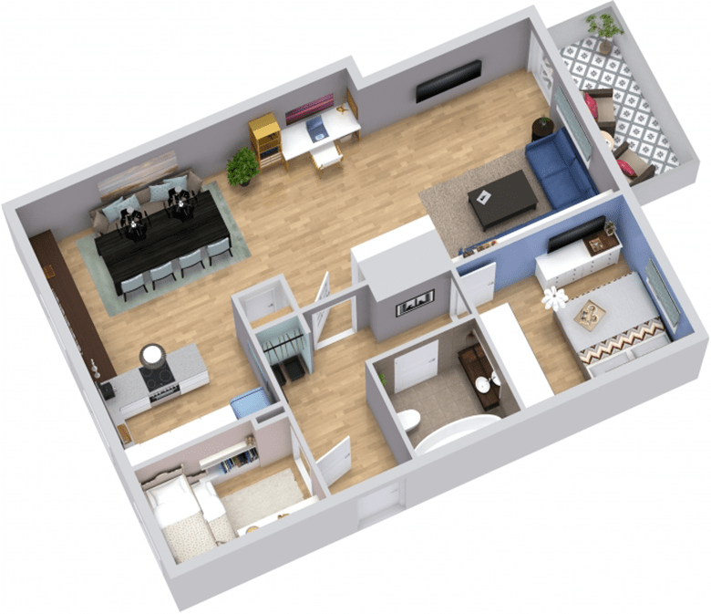
Wat makes a data scientist?
Data cleaning
Data prep
Advanced analytics
Data scientist
Data exploration
Data visualisatie
Kritisch denken
Vertalen business
Presentatie resultaten
Stapsgewijze aanpak
GDPR & Ethiek

Slide 42
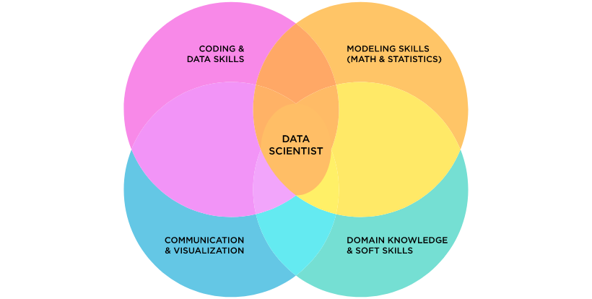
Balance between hard & soft skills

Slide 43
OR Engineer – heavy math/modelling skills
OR
ENGINEER
(Operations Research)
Optimization
Heuristics
Testing
Coding

Slide 44
Data engineer, heavy technical/coding skills
DATA ENGINEER
Data sources
Data structures
Automation

Slide 45
Data analyst, good communicator who can code a bit
DATA ANALYST
(BI)
Dashboards
Ad hoc analysis
Support

Slide 46
Data strategist, domain expert with some coding skills
Develop strategies
Project management
Stakeholder management
Translating business problems
Presentations
DATA STRATEGIST

Slide 47
Data scientist, a mix of everything
Optimization
Heuristics
Testing
Coding
OR
ENGINEER
Data sources
Data structures
Automation
DATA ENGINEER
Dashboards
Ad hoc analysis
Support
DATA ANALYST
(BI)
Building models
Segmentation / Clustering
Advanced analytics
DATA SCIENTIST
Develop strategies
Project management
Stakeholder management
Translating business problems
Presentations
DATA STRATEGIST
Dependent on maturity/size of company whether the roles are split.

Slide 48
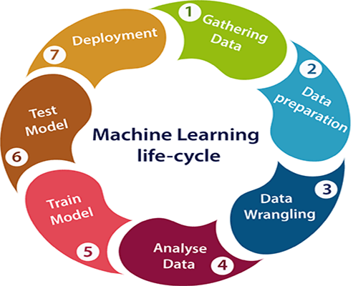
Machine learning life cycle

